Slide 1

Department of Computer Science & Engineering Project Phase 1 Review Presentation
Hybrid Detection of Lung Diseases with Chest X-ray Images using CNN
PROJECT TEAM
Likhitha B H : 1DB19CS080
Neha R Rao : 1DB19CS095
Ruchitha M : 1DB19CS165
Latharani : 1DB20CS405
GUIDE
Prof. Vishesh J
Assistant Professor
Department of CSE
Don Bosco Institute of Technology

Slide 2
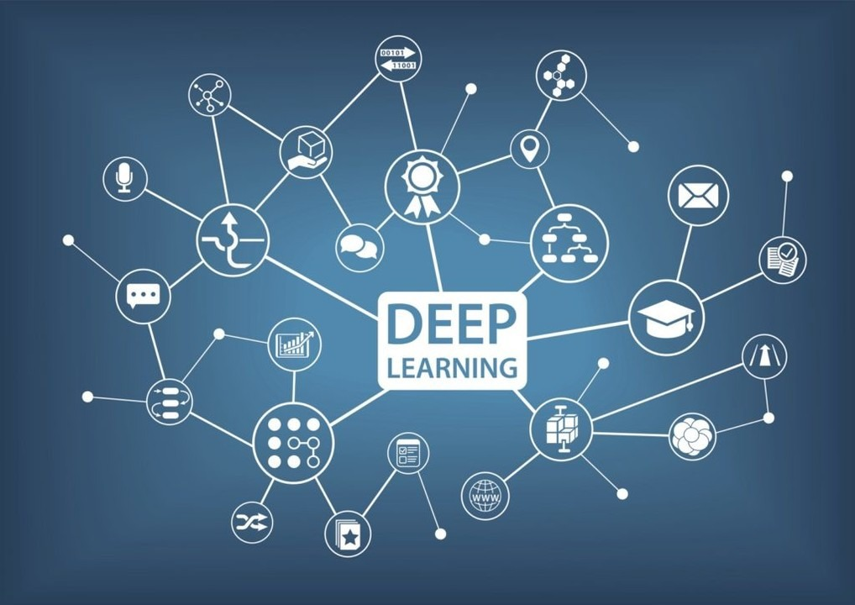
INDEX
INTRODUCTION
LITERATURE SURVEY
PROBLEM STATEMENT
THE WATERFALL MODEL
OBJECTIVES
MODULES
REFERENCES

Slide 3
INTRODUCTION
At first, the COVID-19 outbreak was declared by Wuhan, China in December 2019 which was highly widespread by March 2020.
Early detection of COVID-19, pneumonia and lung cancer is critical for curative therapy and increasing survival rates.
There is a chance that the diagnosis of these diseases could return a false positive result.
This work aims to detect and differentiate these diseases as Normal, COVID-19, Pneumonia and Lung Cancer patients using CNN.

Slide 4
LITERATURE SURVEY
Kanakaprabha.S, et.al,[1] - Analysis of COVID-19 and Pneumonia Detection in Chest X-Ray Images using Deep Learning
The proposed work aims to detect the Normal lungs, COVID19 Infected lungs, Pneumonia Infected lungs from the X-Ray images.
Afonso U. Fonseca, et.al,[2] - Screening of Viral Pneumonia and COVID-19 in Chest X-ray using Classical Machine Learning.
A study to explore classic machine learning methods for the automatic detection of COVID-19 pneumonia cases from CXR images.
Mohammad Farukh Hashmi, et.al,[3] - Efficient Pneumonia Detection in Chest Xray Images Using Deep Transfer Learning.
The proposed methodology uses a deep transfer learning algorithm that extracts the features from the X-ray image that describes the presence of disease automatically and reports whether it is a case of pneumonia.
.

Slide 5
LITERATURE SURVEY
Saeed S. Alahmari, et.al,[4] - A Comprehensive Review of Deep Learning-Based Methods for COVID-19 Detection Using Chest X-Ray Images.
This review paper summarizes deep learning approaches for COVID-19 detection using chest X-ray images and provide potential improvements for higher accuracy.
Vinod Kumar, et.al,[5] - Detection system for lung cancer based on neural network: X-Ray validation performance.
In this paper, the author developed a lung cancer detection system for early detection of lung cancer by studying lung Xray images using number of steps.

Slide 6
PROBLEM STATEMENT
To implement an image classification model that detects and categorizes the chest X- Ray images into Normal, Pneumonia, COVID-19 and Lung Cancer using chest X Ray images in CNN .
Existing Systems doesn’t accurately categorize the covid, pneumonia and lung cancer accurately.
In the proposed system, features of the lungs are extracted and is used to increase the resolution and efficiency level of a given input.

Slide 7
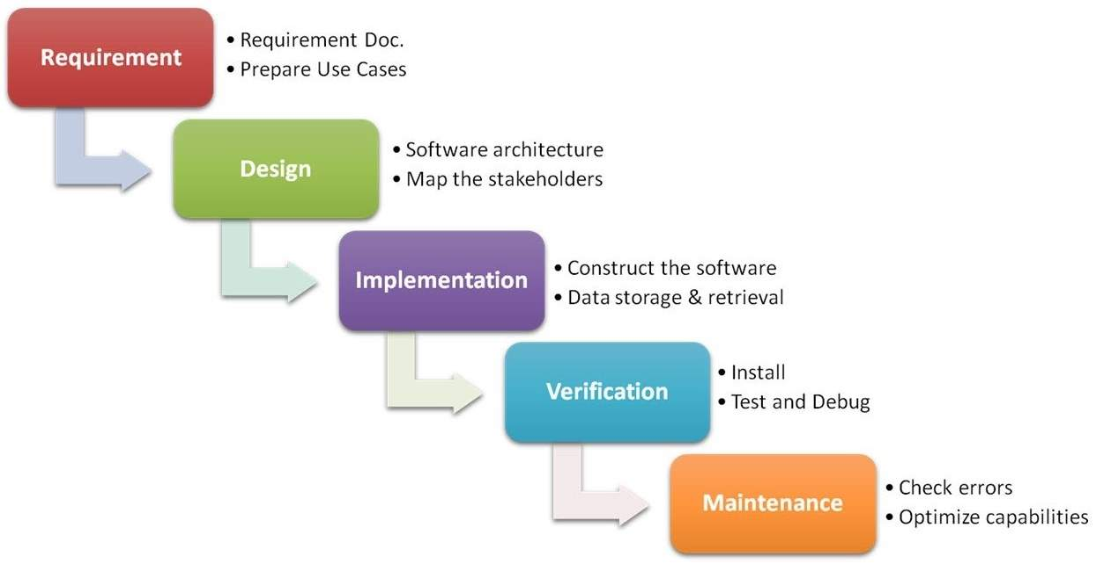
THE WATERFALL MODEL

Slide 8
OBJECTIVES
The Main objective of the project is to detect Lung diseases in patients using Chest X-Ray Images through the following steps:
Upload X-Ray Images - The system should be capable of getting X-Rays from users that will be utilized by the Model.
Detection of Hybrid Model - The system should be able to detect the COVID-19, Pneumonia and Lung Cancer within the X – Ray images that users have uploaded.
Display Results - The system should be able to give information that the user can appropriately understand and gain insight from it.

Slide 9

MODULES
The different modules that we will be incorporating in our project are as follows:
Login Module
Data Collection and Processing Module
Hybrid Module
Result Analysis

Slide 10
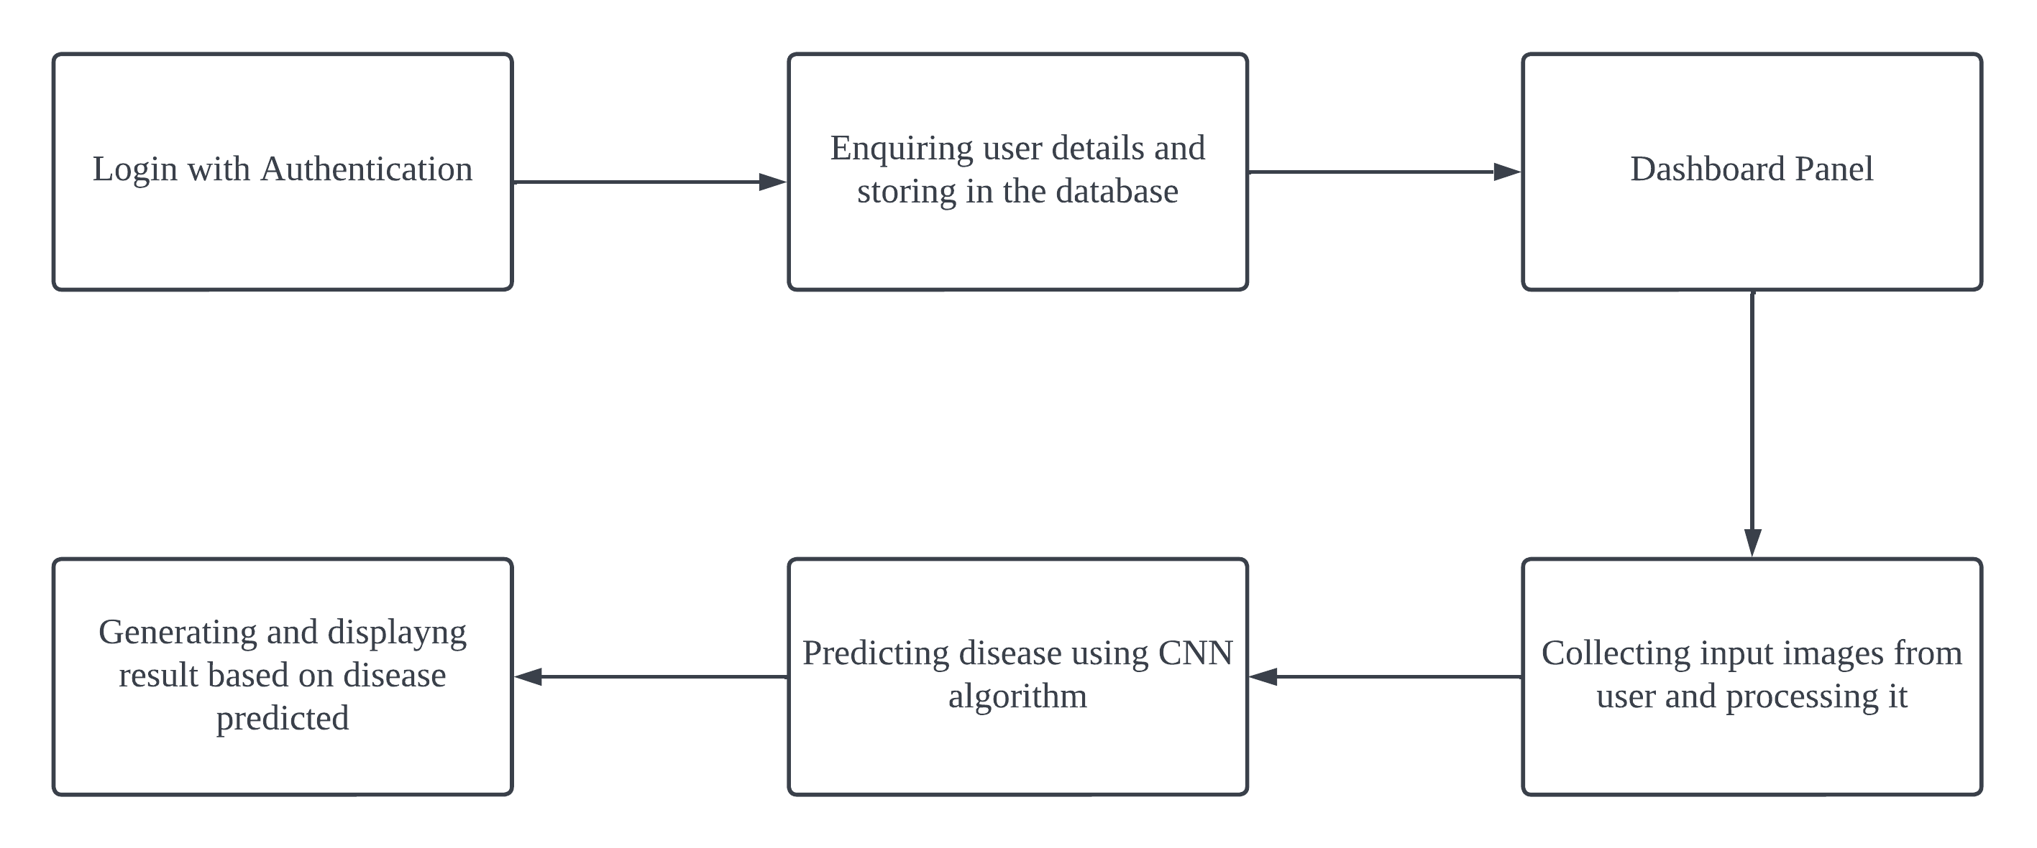
MODULES
Fig : Architecture of the proposed system

Slide 11
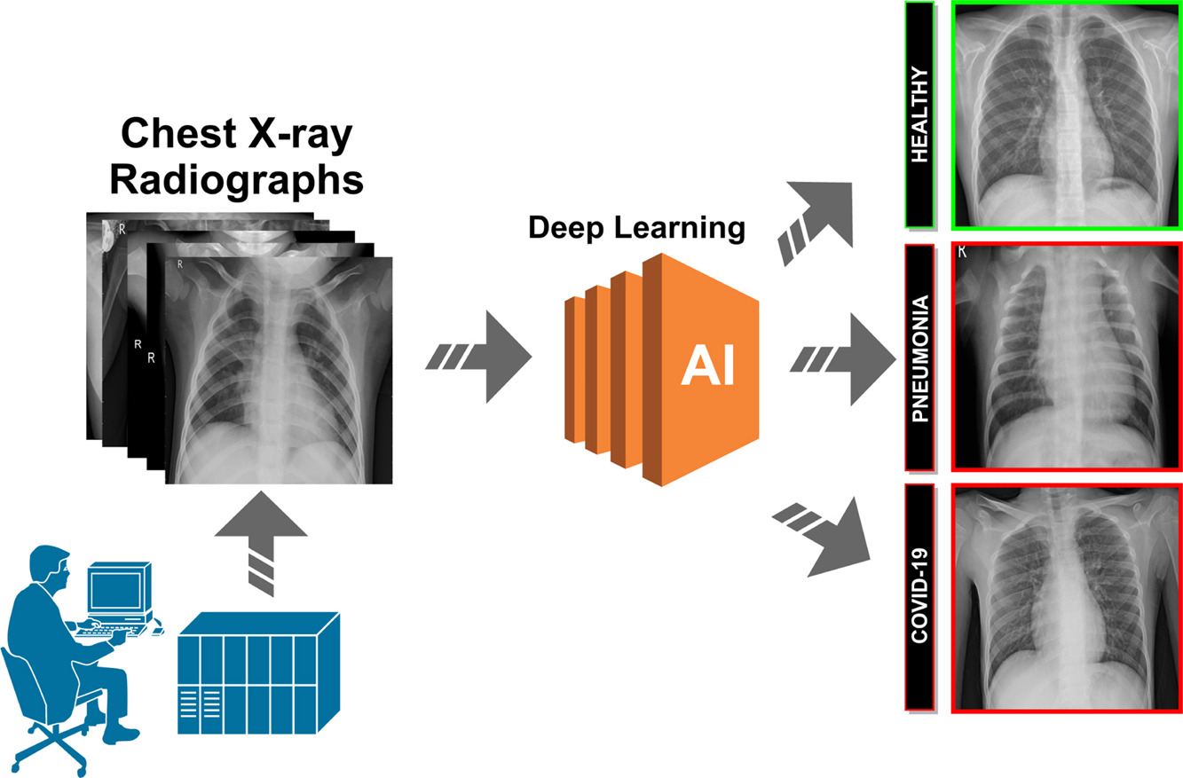
MODULES
Fig : Image classification model that categorizes Healthy, Covid-19 and Pneumonia

Slide 12
REFERENCES
Kanakaprabha. S., D. Radha. (2021). Analysis of COVID-19 and Pneumonia Detection in Chest X-Ray Images using Deep Learning.
Afonso U. Fonseca, et.al,(2021). Screening of Viral Pneumonia and COVID-19 in Chest X-ray using Classical Machine Learning.
Mohammed Farukh Hashmi, et.al, (2020). Efficient Pneumonia Detection in Chest Xray Images Using Deep Transfer Learning.
Saeed S. Alahmari, et.al,(2022). A Comprehensive Review of Deep Learning-Based Methods for COVID-19 Detection Using Chest X-Ray Images
Vinod Kumar, et.al,(2013). Detection system for lung cancer based on neural network: X-Ray validation performance.

Slide 13
THANK YOU

